Slide 1

PROJECT ON MPURPOSE-MASTER
DEPARTMENT OF COMPUTER SCIENCE & ENGINEERING
PRESENTED BY
A.C.SARADA 124E1A0542

Slide 2
ABSTRACT
By using these website any one can know the all information about protfolios and any other pages.
By using these website each and every one can know the blog details about color schemes, Swhowcase PSD, mixin library etc.
These website is user friendly to know the all blog details and choose the best information.

Slide 3
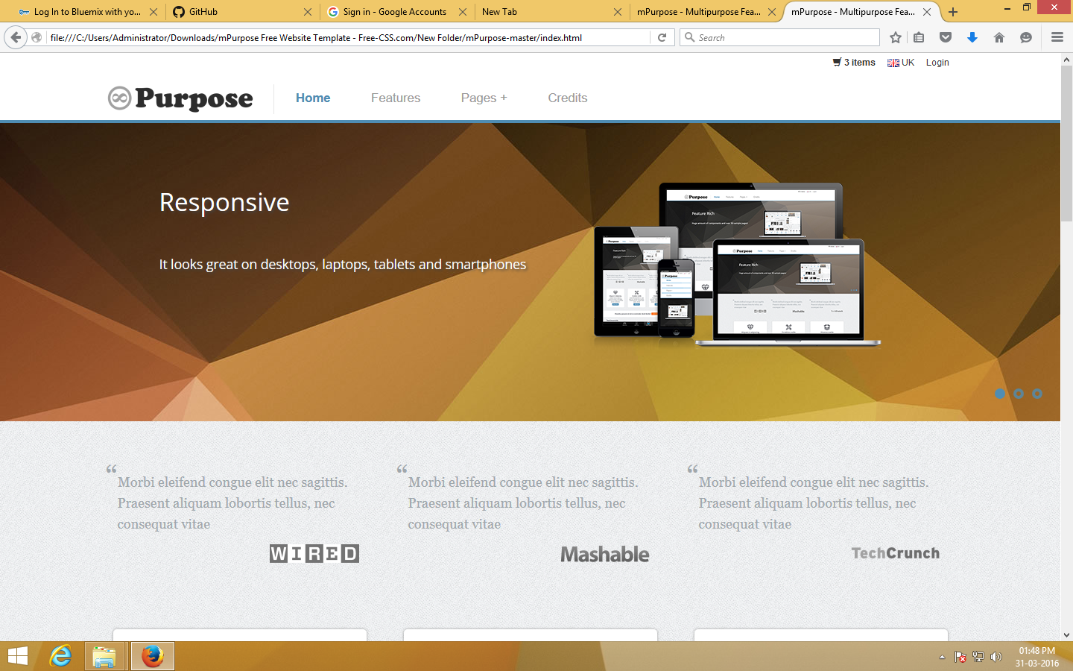

Slide 4
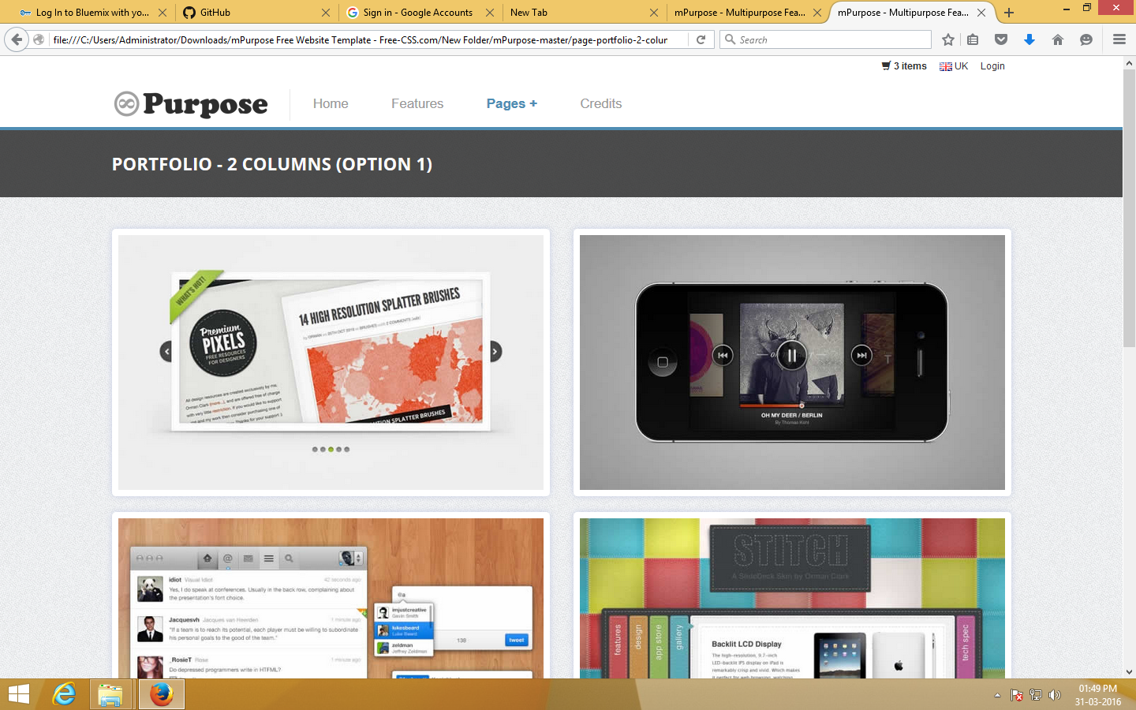

Slide 5
THANK YOU

